Slide 1
UNIT Testing - introduction

Slide 2
What is a software test and what does it do?
It is a piece of software, which executes another piece of software
It validates if the code is in the expected state or executes the expected sequence of events.

Slide 3
Why is a software test helpful?
It helps the developer verify if the logic of a piece of the program is correct
It helps to identify software regression made by changes in the source code

Slide 4
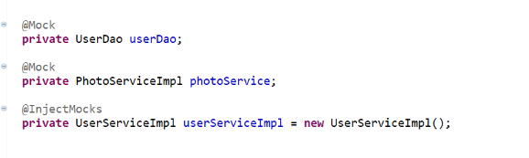
Unit-testing
It is a piece of code written by the developer that executes a specific functionality in the code to be tested and asserts a certain behavior or state
It usually targets a small unit of code(e.g. a method or a class)
External dependencies are removed, by replacing them with a test implementation or an object created by a test framework(mock)

Slide 5

Junit

Slide 6
Annotation
@Test
The Test annotation tells JUnit that the public void method to which it is attached can be run as a test case
@Before
Several tests need similar objects created before they can run. Annotating a public void method with @Before causes that method to be run before each Test method.

Slide 7
Annotation
@BeforeClass
Annotating a public static void method with @BeforeClass causes it to be run once before any of the test methods in the class.
@AfterClass
This will perform the method after all tests have finished. This can be used to perform clean-up activities.
@Ignore
The Ignore annotation is used to ignore the test and that test will not be executed

Slide 8
Methods & Description
void assertEquals(boolean expected, boolean actual)
void assertTrue(boolean condition)
Void assertFalse(boolean condition)
Void assertNotNull(Object object)
Void assertNull(Object object)
Void assertArrayEquals(expectedArray, resultArray)
Checks that two primitives/object are equal
Checks that a condition is true
Checks that a condition is false
Checks that an object isn't null
Checks that an object is null
The assertArrayEquals() method will test ehether two arrays are equal to each other

Slide 9
How does it work?
To run the method, JUnit first constructs a fresh instance of the class then invokes the annotated method.
Any exceptions thrown by the test will be reported by JUnit as a failure. If there aren't any exceptions thrown, the test is assumed to have succeeded.
The Test annotation supports two optional parameters: expected and timeout. The first declares that a test method should throw an exception. If it doesn’t throw or if it throws a different one than the expected, the test fails.
The second parameter causes a test to fail if it takes longer than a specified amount of time(measured in milliseconds).

Slide 10


Example
Expected Parameter
Timeout Parameter

Slide 11
Test stubs

Slide 12
What is a test stub?
It is a program that simulates the behavior of software components
It is a piece of code used to stand in for some other programming functionality or be a temporary substitute for yet-to-be-developed code
It is actually a routine that doesn't do anything other than declaring itself and the parameters it accepts and returning something that is usually the value expected
A stub is commonly used as placeholders for implementation of a known interface, where the interface is finalized/known, but the implementation is not yet known/finalized.

Slide 13
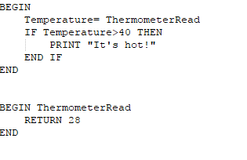
example
ThermometerRead is a function intended to read some hardware device, but the function does not contain the necessary code.
In essence, it does not simulate any process, yet it does return a legal value, allowing the program to be at least partially tested.

Slide 14
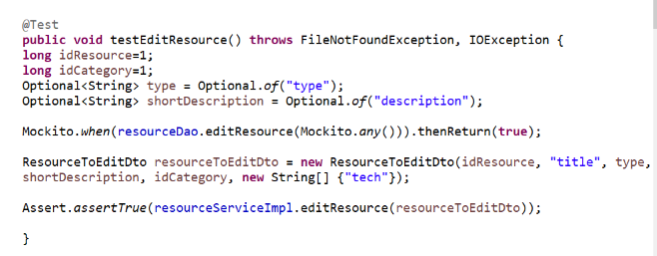
The when-then mantra
The when(mock)-thenReturn(value) method is used to specify the stub value for a method.

Slide 15
Difference between Stubbing and Mocking
stubbing
mocking
A stub is a fake class that comes with preprogrammed return values.
The stub is injected into the class under test to give you absolute control over what's being tested as input
A typical stub is a database connection that allows you to mimic any scenario without having a real database.
A mock is a fake class that can be examined after the test is finished for its interaction with the class under test.
Typical mocks are classes with side effects that need to be examined, e.g. a class that sends emails or sends data to another external service.

Slide 16

Mockito

Slide 17
Why drink it?
Mockito is a mocking framework that tastes really good. It lets you write beautiful tests with a clean & simple API. Mockito doesn’t give you hangover because the tests are very readable and they produce clean verification errors.

Slide 18
How do I drink it?
Recommended way of getting Mockito is declaring a depency on “mockito-core” library using your favorite build system. With Gradle one can do:
repositories { jcenter() }
dependencies { testCompile "org.mockito:mockito-core:2.7.22" }

Slide 19
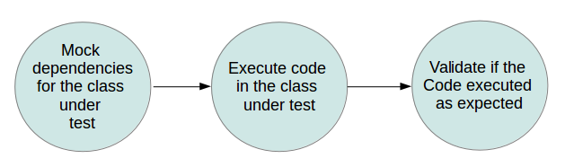
Using mockito for mocking objects
Mockito is a popular mock framework which can be used in conjunction with JUnit. Mockito allows you to create and configure mock objects. Using Mockito simplifies the development of tests for classes with external dependencies significantly.
If you use Mockito in tests you typically:
- Mock away external dependencies and insert the mocks into the code under test
- Execute the code under test
- Validate that the code executed correctly

Slide 20
Basics Annotations
@Mock
-use @Mock to create and inject mocked instances
@Spy
-use annotation to spy on an existing instance
@InjectMocks
-use to inject mock fields into the tested object automatically
@Mock
private UserDao userDao;
@Spy
List<String> spiedList = new ArrayList<String>();
@InjectMocks
private UserServiceImpl userServiceImpl = new UserServiceImpl();

Slide 21
Difference between spy and mock
When Mockito creates a mock – it does so from the Class of an Type, not from an actual instance. The mock simply creates a bare-bones shell instance of the Class, entirely instrumented to track interactions with it.
On the other hand, the spy will wrap an existing instance. It will still behave in the same way as the normal instance – the only difference is that it will also be instrumented to track all the interactions with it.

Slide 22
Notes
Use annotation to minimize repetitive mock creation code
Use annotation to make the test more readable
Use @InjectMocks to inject both @Spy and @Mock instances

